Slide 1
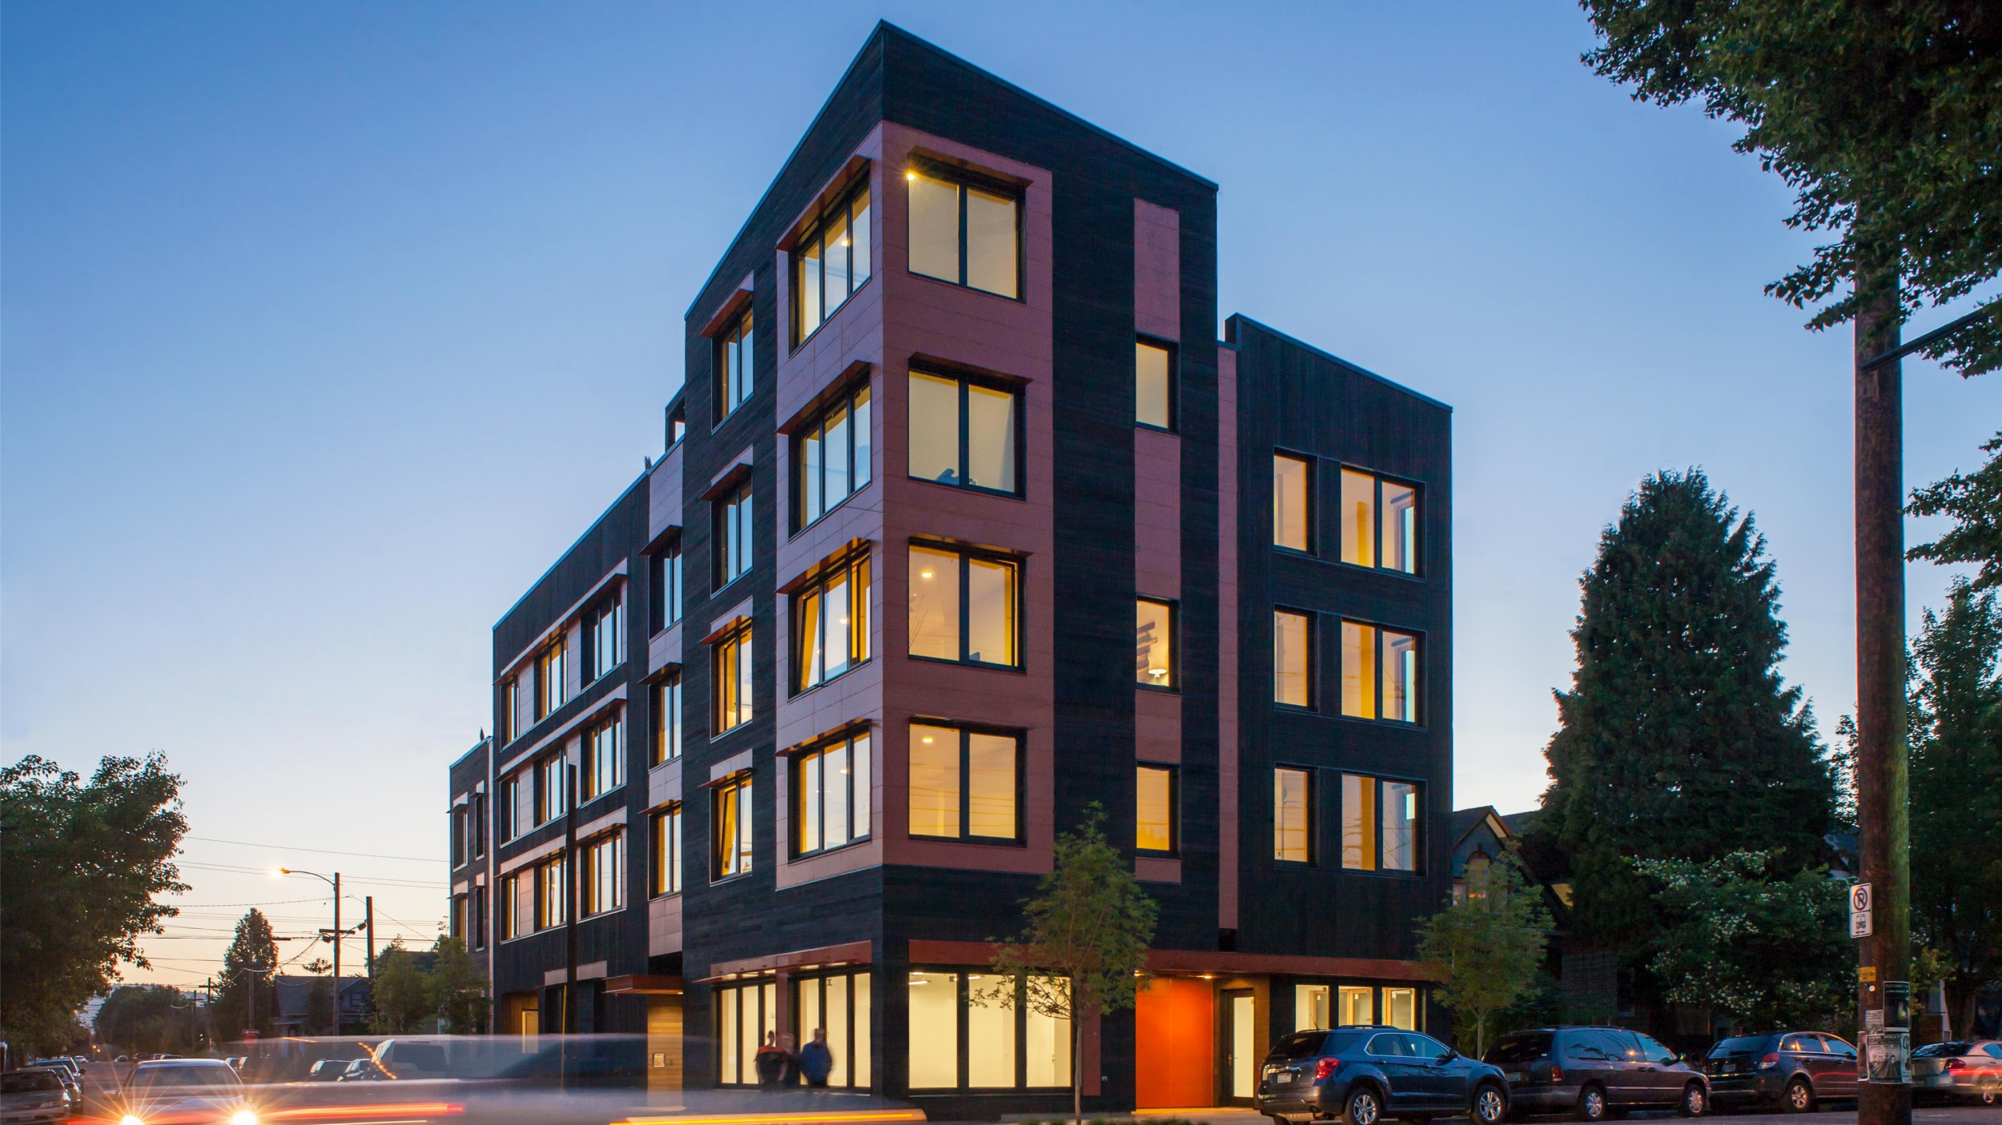
Predicting House Prices in Bengaluru
BY
Rekha. J

Slide 2
Problem Statement
In the booming real estate market of Bangalore, accurately predicting property prices is crucial for buyers, sellers, and real estate companies . Our project aims to address this challenge by leveraging machine learning techniques to develop a predictive model that evaluates property prices based on location and key features. By analyzing historical data, we seek to empower stakeholders with reliable insights to make informed decisions in the dynamic Bangalore housing market.

Slide 3
DATASET
There are 13,320 observations in our dataset, consisting of 9 columns/attributes.
The columns are: area_type, availability, location, size, total_sqft, bath, society, balcony, and price.
We have used a total of 5 features to train our machine learning model.

Slide 4
LOAD DATA
DATA CLEANING
METHODOLOGY
DATA PREPARING
DATA MODELING

Slide 5
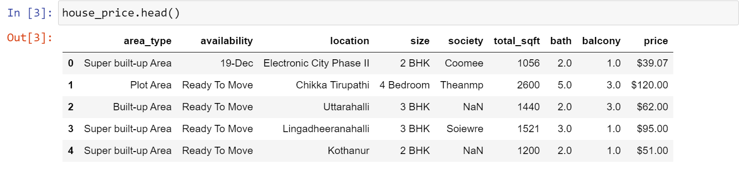
Snapshot of dataset

Slide 6
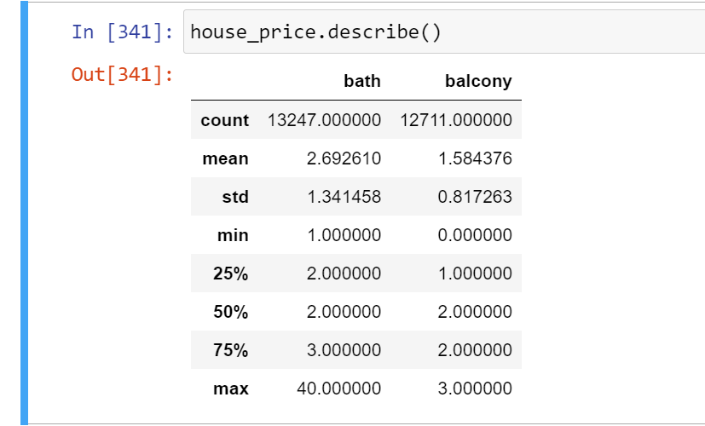
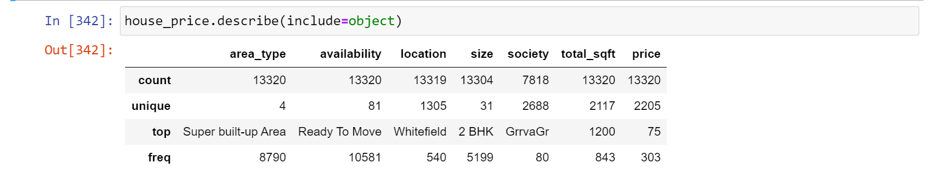
Snapshot of dataset

Slide 7
DATA CLEANING
The primary goal of data cleaning is to identify and rectify errors, inconsistencies, and missing values in the dataset to ensure its reliability and quality.
This process is commonly performed using the popular pandas library in Python.
Initially, irrelevant columns or features that do not contribute significantly to predicting the final price are often dropped from the dataset.
Rows containing missing values (null values) in any columns are also removed to maintain data integrity.
Furthermore, data cleaning may involve converting columns containing non-numeric characters into numerical values to facilitate analysis. Many more techniques are used to improve the overall quality and consistency of the dataset.

Slide 8
Handle null values
Feature Engineering
Add new feature (bedrooms)
Fix (total_sqft) feature
Add new feature called (price_per_sqft)
DATA CLEANING
Dimensionality reduction for categorical feature (location)
Outlier removal
Outlier removal has been performed using domain knowledge and insights gained from the data. Specifically, outliers in features such as bhk, ’bathrooms’ and 'price_per_sqft' have been identified and removed based on considerations such as the property's location and other relevant factors.

Slide 9
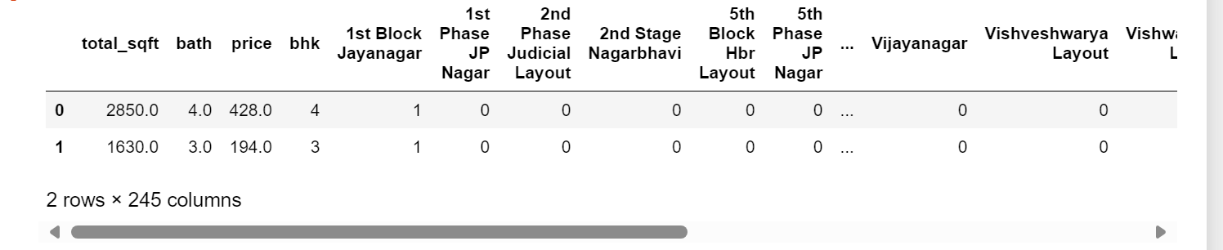
DATASET AFTER CLEANING

Slide 10
MODEL CREATION
The process of modeling involves training a machine learning algorithm to predict labels (target variable) from the provided features.
In this project, I employed a linear regression algorithm for training and testing the model.
Achieving an R-squared value of 0.71 indicates that our model has learned significant patterns in the data and shows promise for predicting the target variable.

Slide 11
K-FOLD CROSS VALIDATION
Cross-validation is a statistical method used to estimate the performance or skill of machine learning models
By dividing the dataset into multiple subsets (folds), training the model on a subset, and evaluating its performance on the remaining data, cross-validation provides a robust estimate of the model's performance on unseen data. This process is repeated multiple times, with each subset serving as both the training and testing data, allowing for a comprehensive assessment of the model's generalization capability.
In our analysis, after applying k-fold cross-validation to our dataset, we consistently observed an accuracy rate exceeding 75%. This indicates that our model demonstrates strong performance across different folds of the data and is likely to generalize well to unseen data.

Slide 12
GRID SEARCH CROSS VALIDATION
We utilized the grid search cross-validation technique on our dataset, exploring various algorithms including linear regression, lasso regression, and decision trees.
Through this process, we identified that the linear regression algorithm yielded the highest accuracy score, exceeding 75%.
This demonstrates the effectiveness of grid search cross-validation in selecting the best algorithm and optimizing its parameters for our dataset

Slide 13
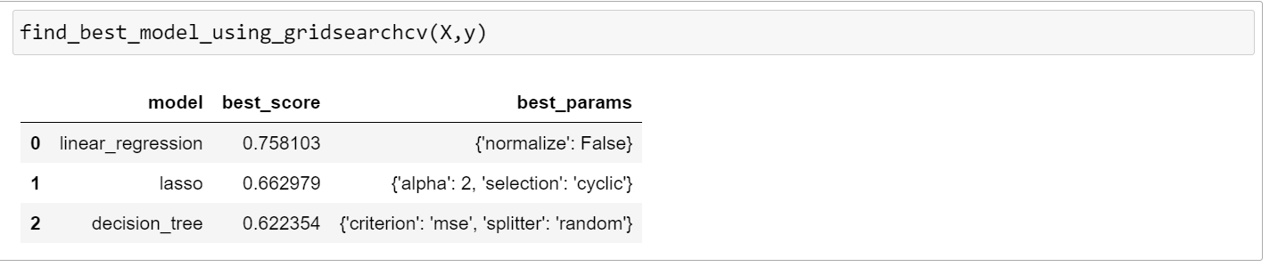
We see that linear regression performs best with best params as normalize = False

Slide 14
Thank You

